Slide 1


Green Harbour
Sustaining the future
Green Harbour specializes in harnessing the
power of renewable resources to meet the
energy needs of today while preserving
the planet for future generations.
Address: IIITRanchi, Khelgaon, 804012
Contact: 9312345678

Slide 2


Promoters and Background
Public Promoters:
Ministry of Renewable Energy (MNRE): It gives PLI.
Indian Renewable Energy Development Agency (IREDA): Gives financial assistance.
Private Promoters:
Reliance New Energy Solar Ltd: Invests in the
startups in the renewable energy sector.
2) Adani Power: Provides technical assistance.

Slide 3


Market Trend
Solar Power Dominance: India has been making significant strides in solar energy. Govt Initiatives like International Solar Alliance (ISA) and various solar parks.
Wind Energy Growth: India has been investing in expanding its wind power
capacity with both onshore and offshore projects.
Renewable Energy Targets: India has set ambitious renewable
energy targets, aiming to achieve 175 GW of renewable
energy capacity by 2025.
International Partnerships: Collaborations with other countries for
knowledge exchange, technology transfer, and capacity building
in renewable energy.

Slide 4
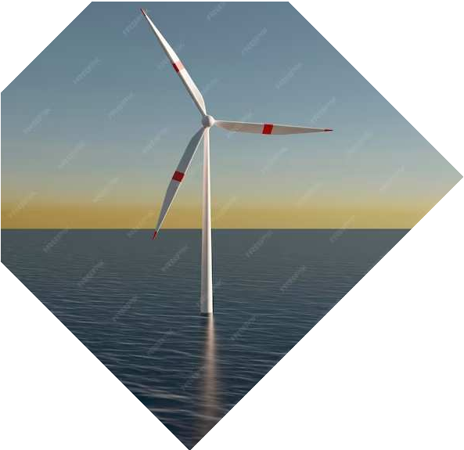

Stakeholders and Entrepreneurial History
Jharkhand Renewable Energy Development (JREDA): JREDA is a state nodal agency for the implementation of renewable energy projects.
It is an autonomous body under the Societies Registration Act 21, 1860
registered on 19th February 2001
Sunson Solar World: Situated in NagarToli, Jharkhand, it is a supplier of Solar LED lantern, water heaters, etc.
Amrut Energy Private Ltd: Situated on Ratu Road, it has actively
Involved in tying up with energy sector startups.

Slide 5

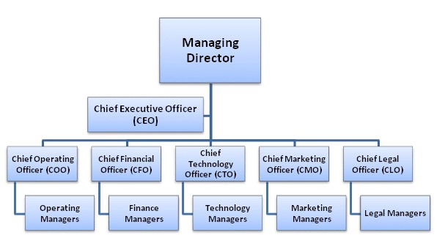

Management Team Priyanav (Chief Executive Officer) Shivam Bhardwaj (Chief Technical Officer) Ankur Kumar (Chief Business Development Officer)
Form of Ownership
Private limited company: It is a privately held business entity
Held by private stakeholders.

Slide 6


Manpower Planning
1. Manpower Requirements: Engineers, technicians,
project managers, sales and marketing professionals,
researchers, and administrative staff.
2. Sources of Manpower Supply: Explore local talent
pools for technical and non-technical positions.
Partnerships with industry associations to attract
skilled professionals.
3. Training Requirements and Costs: Develop a
comprehensive training program to enhance the skills of
existing employees and to onboard new hires. Estimate the
costs associated with training programs.

Slide 7
Business Ventures
Solar Panel Solutions: High-efficiency photovoltaic panels for residential, commercial, and industrial use. Solar panel installation services with customizable design options.
Wind Turbine Solutions: Small to medium-scale wind turbines for localized power generation. Consultation and installation services for wind energy projects
Hydropower Solutions: Small to medium-scale hydropower systems for electricity generation.
Biomass Energy Solutions: Biomass power plants for the
generation of electricity from organic materials.
Scale of Business Operations: Establishing a strong local and regional presence, with a focus on communities with high renewable energy potential.

Slide 8

Types of Employees and Required Technologies:
1)Renewable energy engineers and technicians for system design and installation.
2)Sales and marketing professionals to promote products and services.
3)Customer support staff for ongoing client relationships.
4)Advanced solar panel technologies, including high-efficiency photovoltaic cells.
5)Biomass gasification and combustion technologies for power generation.

Slide 9



Market Plan
1. End Users and Current Demand: The target end users include residential consumers, commercial businesses, industrial facilities, or government entities.
2. Pricing and Promotion Policies: Implementing promotion policies that highlight the environmental benefits, cost savings, and long-term value of renewable energy.
3. Distribution Channels: Multiple distribution channels are established to reach diverse customer segments.
4. Competition and New Markets: The platform is relatively new to the market, so there are very few competitors which can be tackled using quality service.

Slide 10

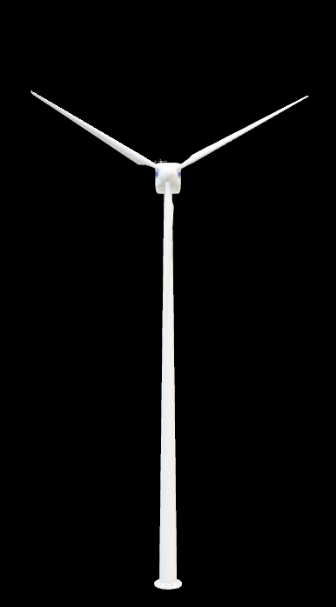
Thanks
"Sustainability is no longer about doing less harm. It's about doing more good."
- Jochen Zeitz

